Slide 1




Cybercrime and Digital Forensics (COM622)
Department of Science & Engineering
Solent University
Week 9 Lecture: Mobile Device Forensic
Dr Daniel Olabanji

Slide 2

Session Overview
Mobile device Forensic
Mobile Communication

Slide 3
ACPO Principle in mobile
No actions by LE should change data held on an IT device, relied on as evidence in court
An investigator must be competent and able to give evidence explaining the implications of their actions
Maintain a record (audit trail) of the process followed that can be followed by a Third party
The person in charge of the investigation has overall responsibility for ensuring that the investigation follows the law, and these principles
Notes:
As discussed in the previous slide there are many Tools but for the purpose of this class we will be focusing on the Dump it

Slide 4

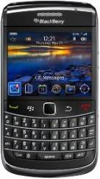
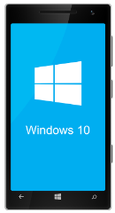
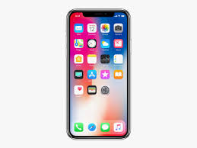
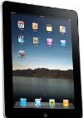
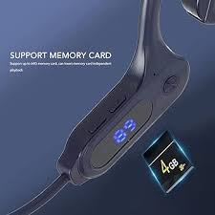
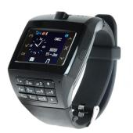
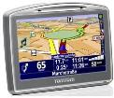
Mobile Device Forensic
Mobile device forensic is a branch of digital forensics relating to recovery of digital evidence or data from a mobile device under forensically sound conditions. This branch of Digital forensic covers:
Standard phone
Smart phone
Novelty phone
Other smart devices (e.g Tablet)
Smart cars
On this device(s) data are stored on:
Non-volatile memory (NAND flash)
Volatile memory (RAM)
SIM
Memory card
Cloud

Slide 5
Evidence Contamination
  In mobile device forensic evidence can be contaminated by the following:
  1. Physical effect e.g Totally burning the phone and SIM
  2. Network (Mobile, Bluetooth and Internet)
  Information might be wiped out from Internet apps.
  Calls, SMS can arrive from mobile network, (occupying deleted items)
  Downloads and Trojans from WIFI can affect the content of the handset.
  Bluetooth connection might leave a print on the flash memory, overwrite files.
  3. Cloud Consideration
  Cloud connection could be used to delete from the content of the phone via cloud access.

Slide 6
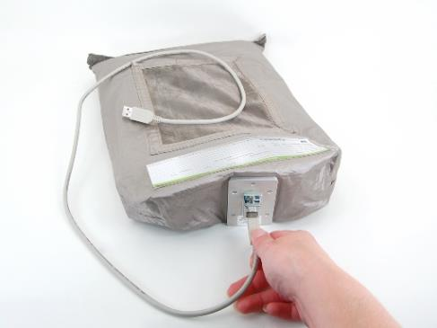
Evidence isolation
  Issues around evidence isolation in Mobile device forensic
Turn off, sometimes needed to be on,
Phone on in Faraday bag or operate in a Faraday tent, (Radio waves are weak and the phone increases it signal strength and thus consumes more power) – not very reliable though.
Phone should be charged fully first. The content of the phone might change by the execution of a scheduled programs, on timer.
Disable network services, possible with clone that don’t copy the encryption key (more about this later) SIM cards, or ask the network provider to disable its connections to the phone under investigation (court order).
“Airplane mode”, possible but not recommended. It involves the investigator to interact with the handset, and use keypads, which might be programmed to delete information.

Slide 7
Evidence isolation
Physical evidence: DNA and fingerprints :- to associate the phone with the suspect, also useful for patterns identification.
Switch off the phone before transporting it. If it is required to be left on for sometimes, keep it charged and then switch it off before moving away.
The handset should be packed in a tight and rigid container to prevent accidental damage.
The container should be placed in an evidence bag sealed and labelled to restrict access.
All sources of evidence should also be collected and photographed at the scene – handset, charger, cables, CDs, memory card, user guides etc…
Take a photograph of the screen – time difference noted, level of the battery, network provider. If the screen is in saving mode, re-activate and take a picture. Charge the battery if necessary at this initial stage.

Slide 8
Evidence isolation cont.
Suspect should not handle the phone after the seizure :- original factory reset, key codes to clear content, removal of SIM card, removal of battery can cause lost from memory.
The security code and phone number should be requested, if not given
  Review seized materials for clues
  Trial and error, type simple sequences 1,2, 3, 4 or 0000, date of birth. After 3 trials the SIM card is blocked.
  Get the PUK from the service provider – court order might be required to unlock the phone. (Personal Unlock Key)
If the phone is immersed in a liquid, remove SIM card and battery and place in a container, send a sample of the liquid or investigation.
If the phone has a visible physical damage, the cause of the damage should be investigated, even if the evidence can still be extracted.

Slide 9
Content of Mobile device Forensic evidence
Call history
SMS and MMS messages
Phonebook information/Contacts
Photos, audio and video files
Network information (e.g. Wi-Fi connections)
GPS information
Web browsing history (how about the private browsing?)
Emails, memos, calendars
Application-based info (contacts, chatting history, etc..)
Electronic documents (Office documents, PDF files, and much more)
Information stored by the network operators: billing information, call logs, cell tower data etc.

Slide 10
Evidence extraction in Mobile Device Forensic
Level 1:Manual Extraction: involves viewing the data content stored on a mobile device by hand.
Level 2: Logical Extraction: connectivity between a mobile device and the forensics workstation is achieved with a connection using either a wired/wireless connection. E.g Autopsy,
Level 3: Physical Extraction: Hex Dumping and Joint Test Action Group (JTAG) extraction methods afford the forensic examiner more direct access to the raw information stored in flash memory. XRY, Cellebrite etc.
Level 4: Chip off Extraction:Chip-Off methods refer to the acquisition of data directly from a mobile device’s flash memory. This extraction requires the physical removal of flash memory.
Level 5: Micro Read: Micro Read involves recording the physical observation of the gates on a chip with the use of an electron microscope.

Slide 11
Mobile Communication

Slide 12
GSM Evolution
The Global System for Mobile Communications (GSM) is a standard developed by the European Telecommunications Standards Institute to describe the protocols for second-generation digital cellular networks used by mobile devices such as mobile phones and tablets.
1G: FDMA (Frequency Division Multiplexing Access), Slow, Analogue no security, big classical handsets, all incorporated into it, only calls.
2G: Europe - GSM ( FDMA+TDMA (Time Division Multiplexing Access)), digital, security, smaller feature handsets with SIM card inside, ( calls, SMS, Media …)
3G: Europe – GSM/UMTS (Global System for Mobile Communication/Universal Mobile Telecommunication System) ( FDMA + CDMA), fast, digital, security, smaller smart handset, USIM card inside (Calls, SMS, MMS, Media, video telephony, e-mails, GPS, Internet, downloaded Apps, …)
4G:Europe/America/All – LTE (Long Term Evolution)- OFDM (Orthogonal Frequency Division Multiplexing), faster speed of laptop or IP-based. Handset Lighter, faster, consume more power, increased functionality. Video conferencing,
5G: all IP based and faster |( 20 Gbits), based on the foundation of 4G. It has smaller multiple cells with tower power.

Slide 13
Other Communication
  Satellite phones:Inmarsat, Thuraya, GlobalSat, Iridium, Terra …
  iDen (Integrated Digital Enhanced Network) used mainly in South America, developed by Motorola, used by push-to-talk devices and mobile phones.
(iDEN) is a mobile telecommunications technology, it provides its users with trunked radio and a cellular telephone. It has been called the first mobile social network.
Trunking is used by many government entities to provide two-way communication for fire departments, police and other municipal services, who all have spectrum allocated to a city, county, or other entity.
WiDEN, is a software upgrade developed by Motorola for its iDEN enhanced specialized mobile radio (or ESMR) wireless telephony protocol. The protocol is generally considered a 2.5G wireless cellular technology.
iDen has support for GSM with SIM cards and CDMA for cellular telephony. (iDEN) Integrated Digital Enhanced Network

Slide 14
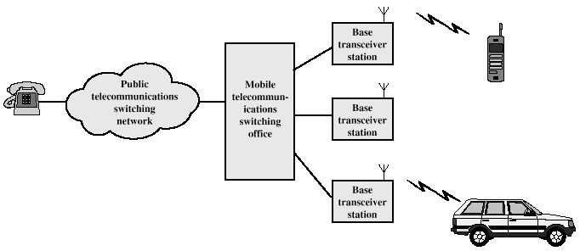
Calling in Mobile network
Base station: antenna + controller (handles calls within the cell)+ transceivers to
communicated on the chosen channel for the cell.
Mobile Telecommunications Switching Office (MTSO) connected by a Wire-line or
wirelessly to the BS, and to the public telephone system. MTSO assigns the voice to the channel, perform hand offs, monitors calls and collects bills.
M
T
S
O

Slide 15
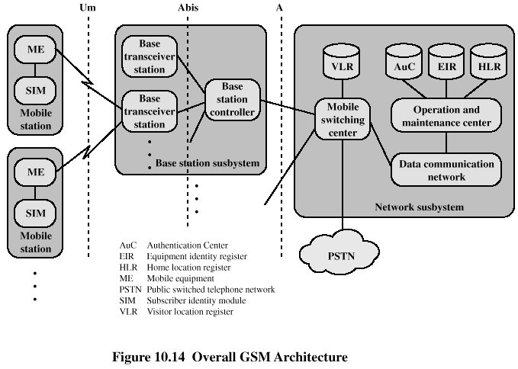
GSM Architecture
  Network providers insert subscriber information into the SIM.
  Only compliant phones with the correct SIM are accepted on the network

Slide 16
Mobile Number identification (MSISDN)
Mobile Station International Subscriber Directory Number (MSISDN) is the phone number uniquely identifying a subscription in GSM/UMTS mobile networks.
The SIM can store 1 or more MSISDN =
Maximum length 15 digits (Each digit is 0..9)
  1-3 digits: for country code (CC)
  1-6 digits: National destination code (NDC)(Geographical location /network provider number
  Remaining digits: Subscriber unique number. (SN)
  NDC + SN is called National significant number <= 15-CC
  Example: 0079107076368 = 00 7 910707 6368
  7: Russia, 910707: Mobile TeleSystems, 6368: Subscriber number
CC
NDC
SN

Slide 17
Mobile Phone identification (IMEI )
International Mobile Equipment Indentifier (IMEI) is a unique identification number for every handset and mobile devices. It benefit includes prevention of stolen, un-active, found, tracking, in the scene of the crime etc. However, it can be stolen and the handset can be cloned.
IMEI can use to identifies the manufacturer, model and country of the approval of the handset. IMEI =
15-digits number = 8 digits TAC + 6 digits Serial number + 1 digit check (Luhn digit)
16-digits if it include the IMEI/SV Software version,
8 digits TAC + 6 digits Serial number + 2 digits (IMEI/SV)
TAC : Type approval code – Old IMEI uses 6 digits, 2 digits for FAC (Final Assembly Code). Until 2002, FAC represents the location of the device. From January 2003 to April 2004, FAC=00. After April 2004, FAC does not exists and TAC takes 8 digits.
The first two digits (XX) reports the body Identifier like BABT – for UK
TAC
SN
CD
Notes:
Tempting with IMEI is an offence.
Stolen handsets have their IMEI reported in CEIR – central equipment.
Get IMEI, type *#06# on the handset. Do it!!!!

Slide 18
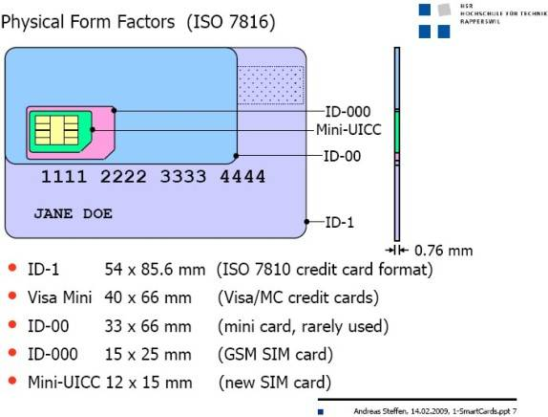
SIM Swapping
SIM (Subscriber Identity Module) card is a smart Micro-controller, like ATM card. SIM swapping has it key role in mobile device forensic and it affect the evidence gathering and analysis.
The GSM specification mandates that when a SIM card is changed records of calls, and other data stored on the handset should be reset.
Most but far from all handsets delete data (Dialled, Missed, Received) when they detect a change of SIM
Change of SIM is usually when the handset is powered up
A process called SIM cloning can be used to 'fool' the handset into thinking that the SIM card has not changed, yet also prevent the phone from access the cellular network...(It is a crime)

Slide 19
CDR
CDR (Call Detail Record) is a file, produced by the cellular providers (the carriers), containing information about telephone exchanges (e.g. calls). The record contains various attributes such as the date, time, duration, completion status, caller and callee numbers, amount of data transmitted or received, during a requested period.
Digital forensic experts can take advantage of the stored information for investigation purposes, reconstructing the suspect’s movements and habits, junctions and meeting with other possible suspects.
Investigator must be aware of the CRD laws within the country of the investigation.
CDR analysis, correlated with mobile extraction, GPS tracks and other digital evidence represents the best way to figure out suspects’ alibi.
CDR DATA RETENTION refers to the records storage and preservation time, according to the country regulations. Carriers collect CDR in their infrastructures. Each one, within limits provided by law, maintains the records for a defined period of time.

Slide 20
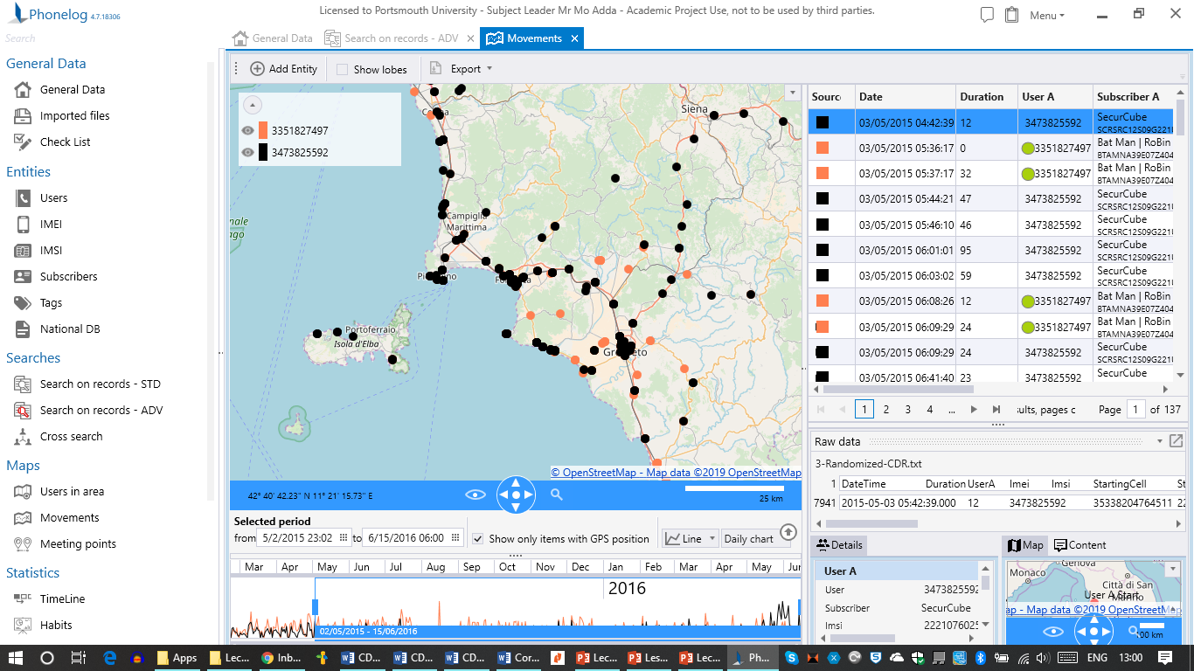
Tools for CDR information Phonelog and it usage
Phonelog
Numberingplans
XRY
Cellebrite
More info can be find in the presentation on SOL

